Slide 1
PCBWay Assembly Orientation Review
5/16/2023

Slide 2
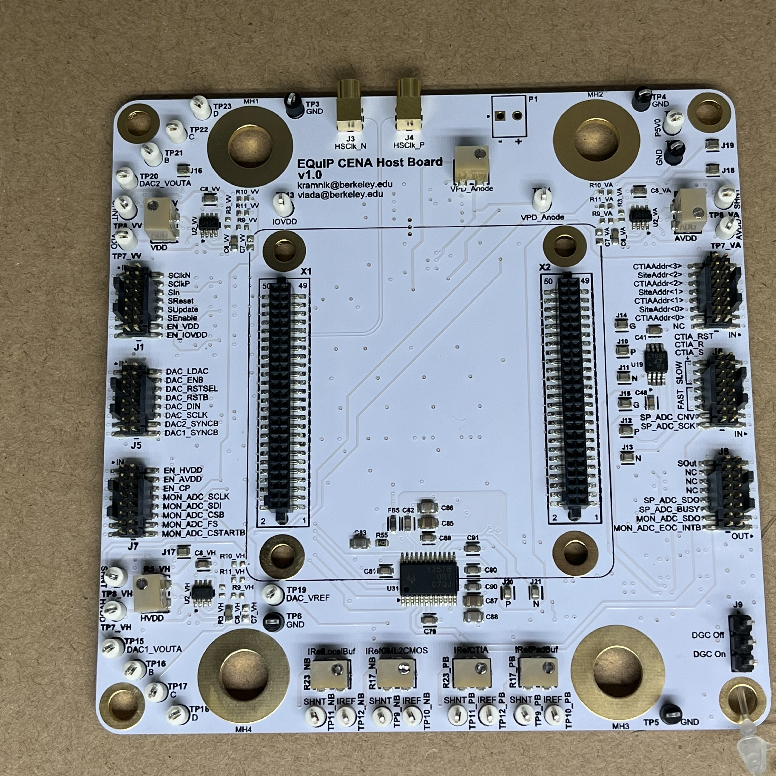
Top Side

Slide 3
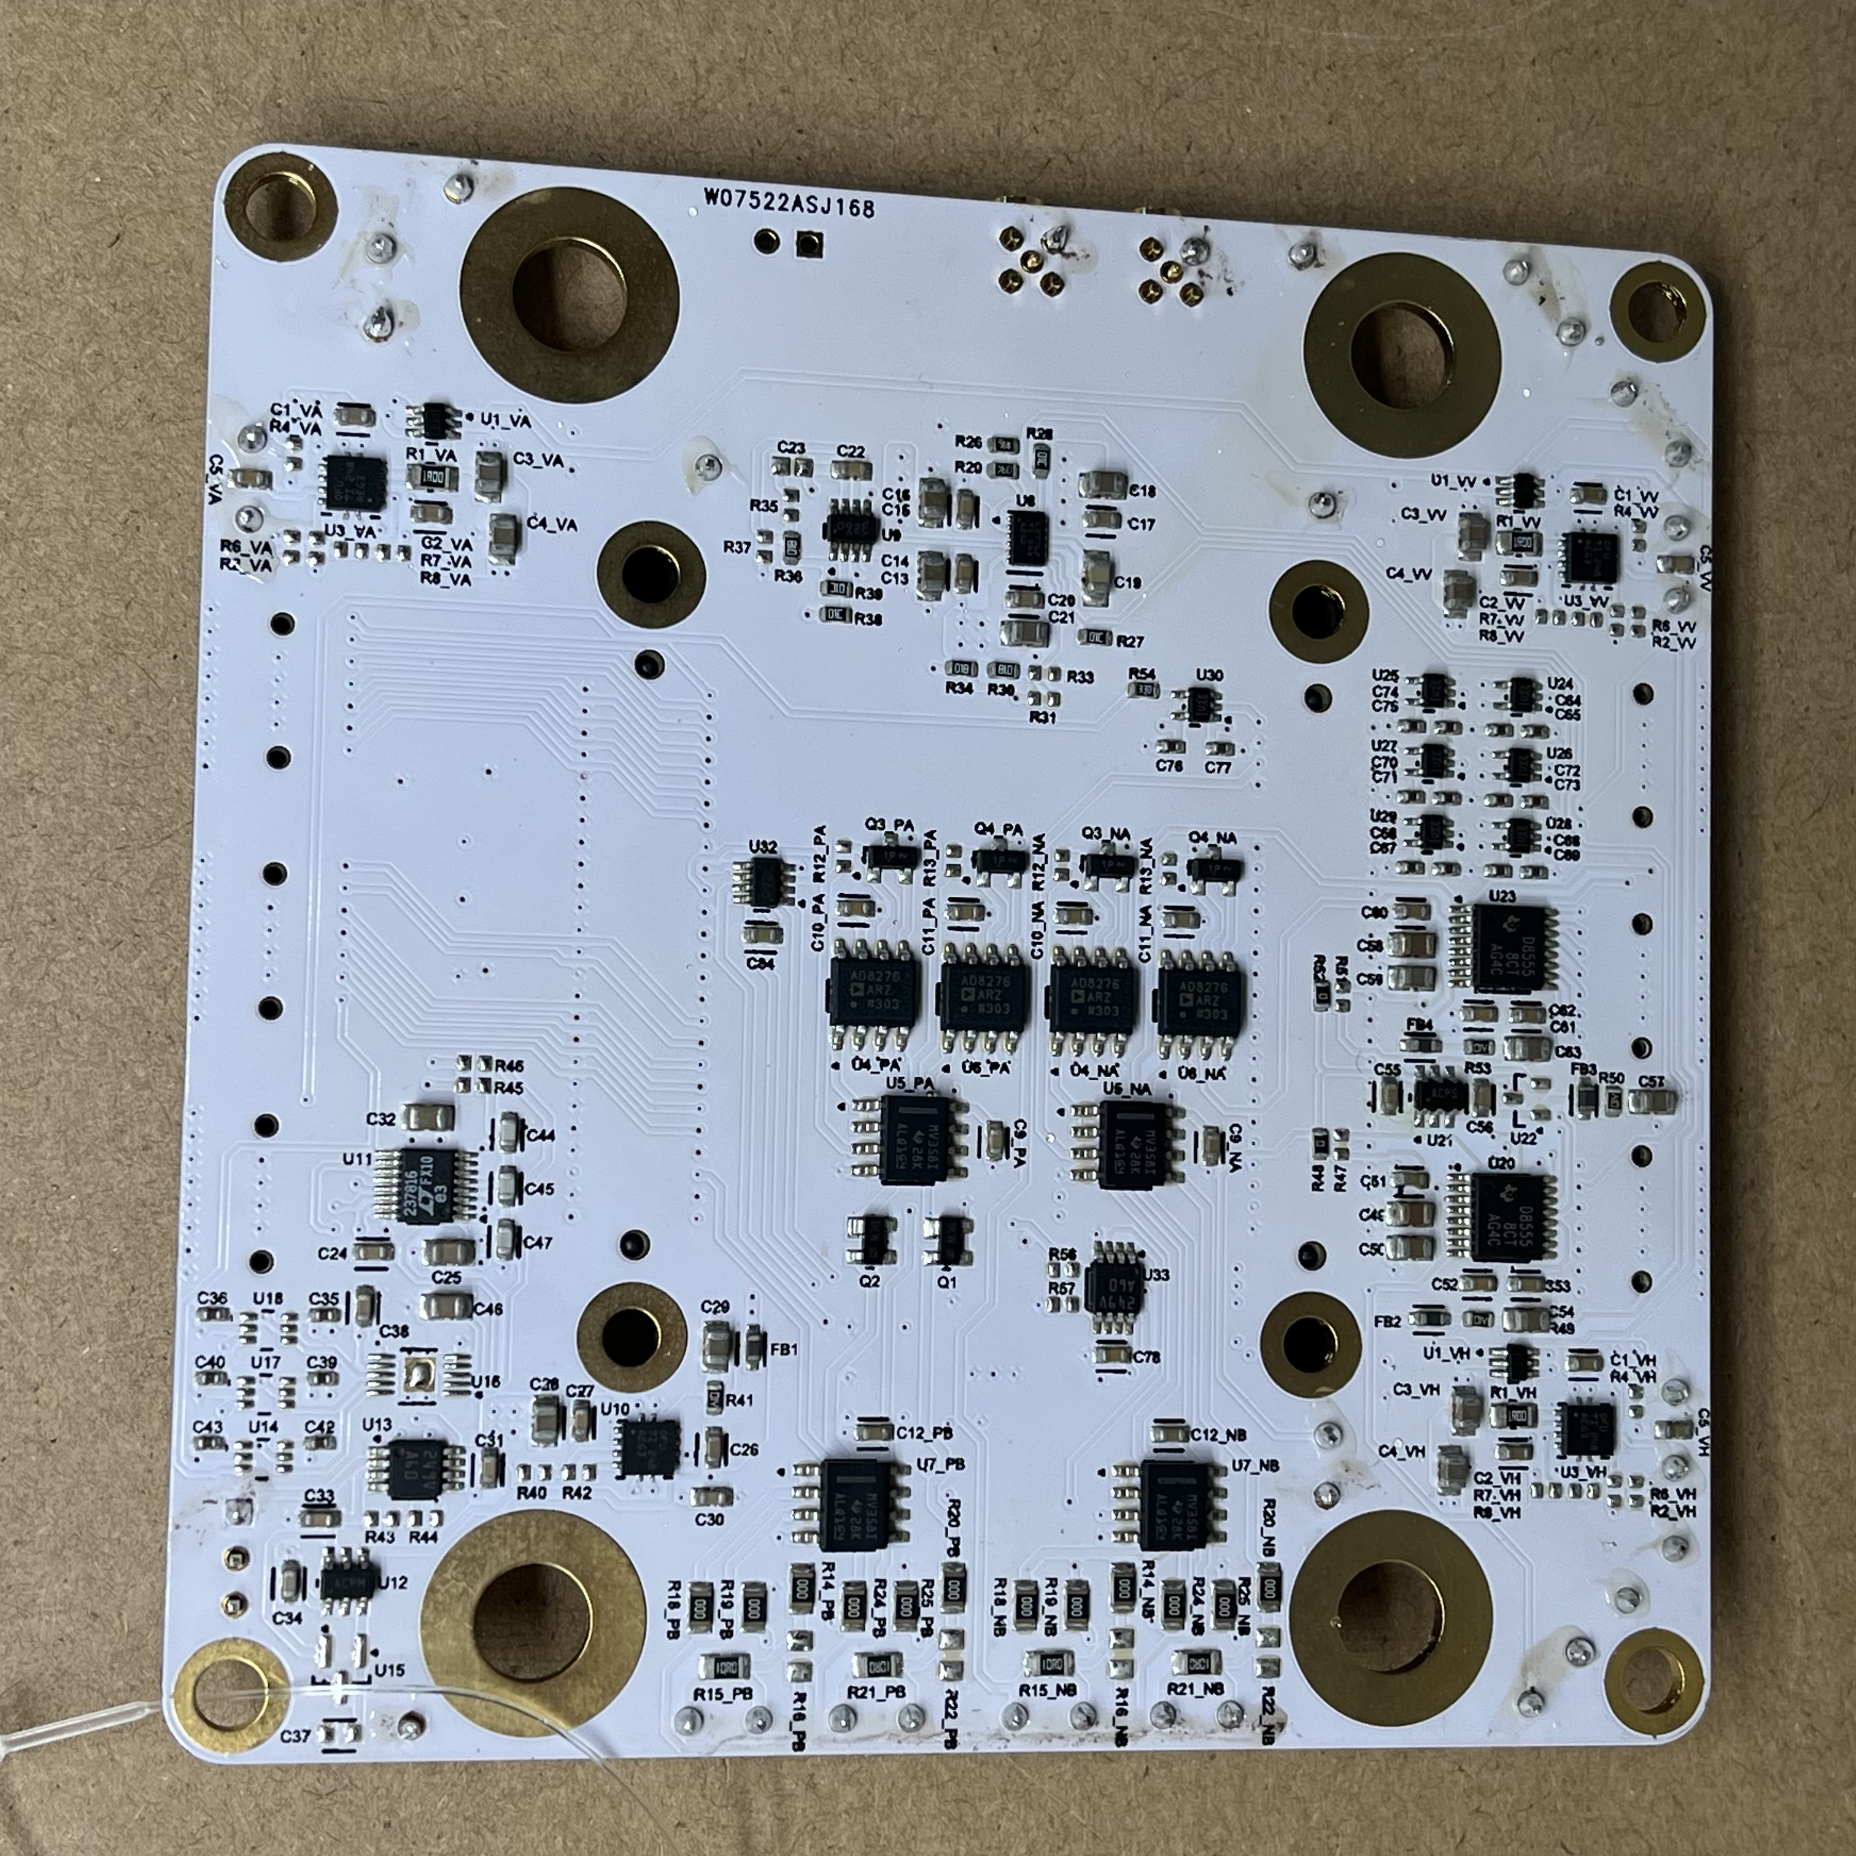
Bottom Side

Slide 4
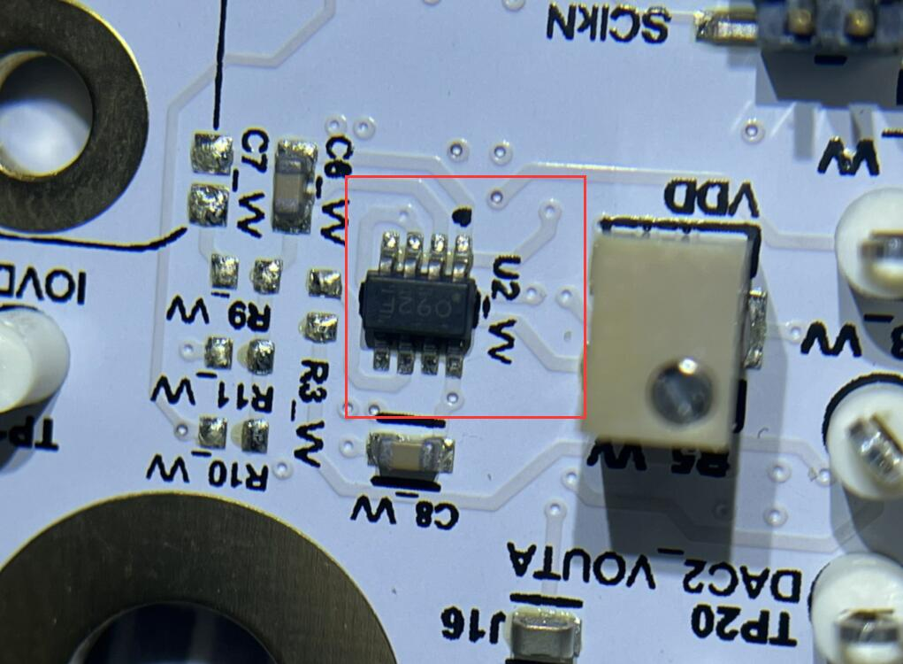
U2_VV
Orientation Correct – Dot on IC matches dot on PCB

Slide 5
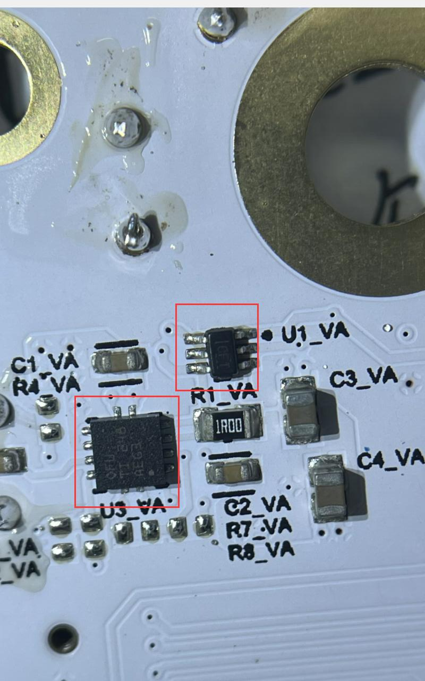
U3_VA,U1_VA
This seems like a PCB layout bug – mirroring the “room” has caused the component footprints to be mirrored into an invalid configuration!

Slide 6
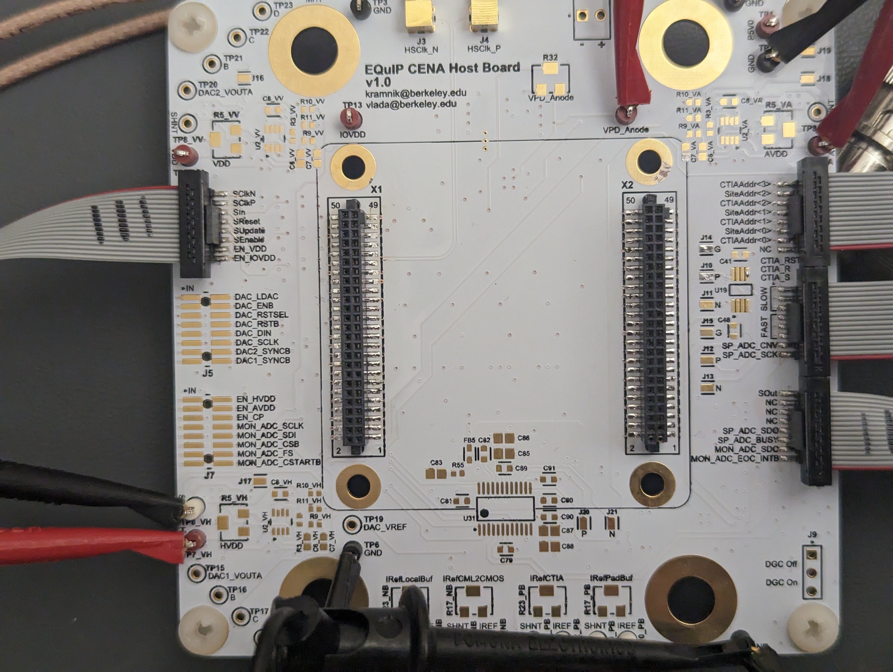
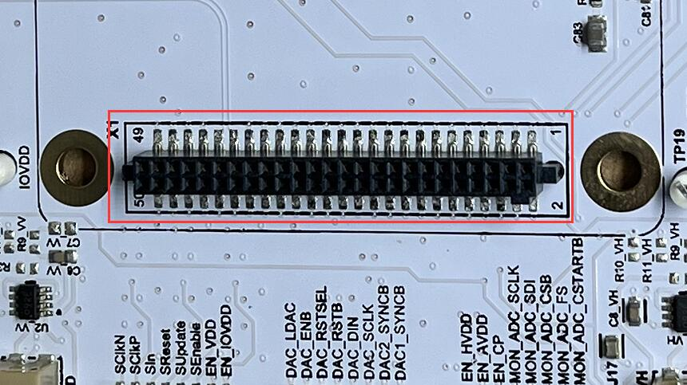
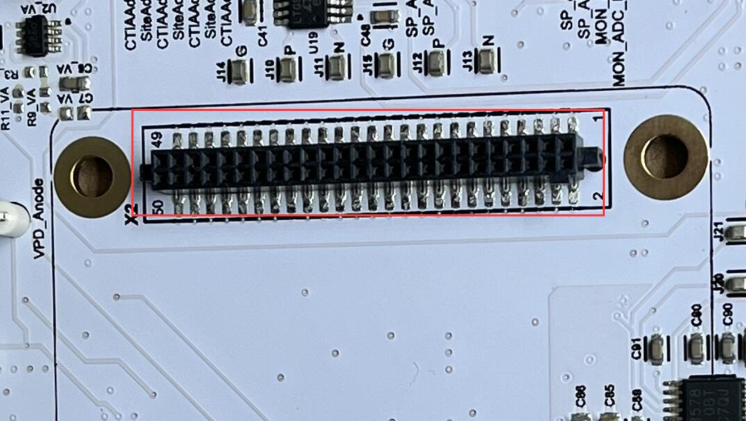
X1,X2 (Chip Board Connectors)
Connectors X1 and X2 need to be rotated 180-deg to match chip board.

